Slide 1
Lab 2 Introduction
Operating Systems, EDA093 - DIT400

Slide 2
Pintos
Time to explore an operating system!
Pintos already implements a simple threading system
Thread creation and termination
Synchronization primitives (semaphores, locks, condition variables)
But this system has problems:
Wait is based on a spinlock (i.e. it just wastes CPU)

Slide 3
Pintos Threading System
struct thread
{
tid_t tid; /* Thread identifier. */
enum thread_status status; /* Thread state. */
char name[16]; /* Name (for debugging purposes). */
uint8_t *stack; /* Saved stack pointer. */
int priority; /* Priority. */
struct list_elem allelem; /* List element for all-threads list.*/
/* Shared between thread.c and synch.c. */
struct list_elem elem; /* List element. */
You add more fields here as you need them.
#ifdef USERPROG
/* Owned by userprog/process.c. */
uint32_t *pagedir; /* Page directory. */
#endif
/* Owned by thread.c. */
unsigned magic; /* Detects stack overflow. */
};
~/pintos/src/threads/threads.h

Slide 4
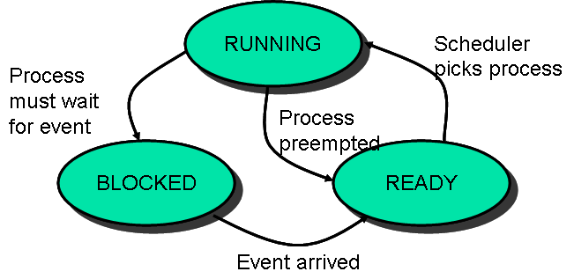
Pintos Threading System
struct thread
{
tid_t tid; /* Thread identifier. */
enum thread_status status; /* Thread state. */
char name[16]; /* Name (for debugging purposes). */
uint8_t *stack; /* Saved stack pointer. */
int priority; /* Priority. */
struct list_elem allelem; /* List element for all-threads list.*/
/* Shared between thread.c and synch.c. */
struct list_elem elem; /* List element. */
You add more fields here as you need them.
#ifdef USERPROG
/* Owned by userprog/process.c. */
uint32_t *pagedir; /* Page directory. */
#endif
/* Owned by thread.c. */
unsigned magic; /* Detects stack overflow. */
};
~/pintos/src/threads/threads.h

Slide 5
Threads continued….
Look at:
threads/thread.h
threads/thread.c
threads/synch.h
threads/synch.c
to understand
How threads are created and executed
How the provided scheduler works
How the various synchronizations primitives (locks, semaphores, condition variables) are implemented

Slide 6
Implementation Suggestions
You may modify functions or add your own code in
threads.h
timer.h
timer.c
There are several tests which test the sleep function in different ways.
Run make check from the ~/pintos/src/threads directory

Slide 7
Implementation Suggestions
The tests alarm-* are for lab2
Ignore the test result of “batch-scheduler” for now. That is for Lab3!
A correct solution should “pass” all these tests.

Slide 8
Submission
Test the code
Write the report
Prepare the archive

